Slide 1
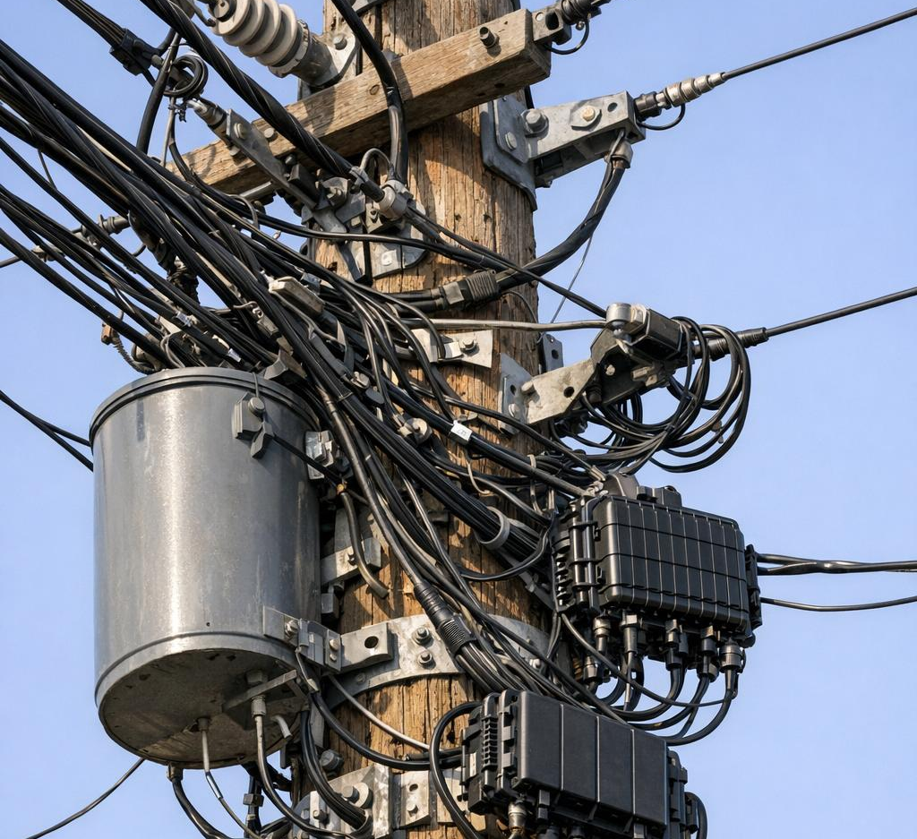
What’s On That Pole?
A Practical Walkthrough for New Telecom Techs Telecom Education & Safety

Slide 2

WHY Are YOU HERE?

Slide 3
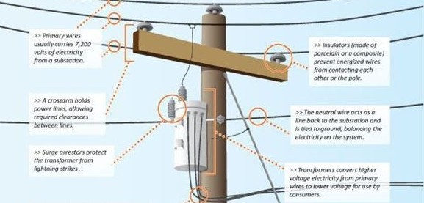
Purpose
The purpose of this training is to introduce you to the fundamental equipment typically mounted on utility distribution poles.
Bear in mind that configurations differ from pole to pole: some carry only a portion of what we cover, while others include additional components, depending on the location and the nature of the service provided.

Slide 4
Primary Wires
Generally will carry 7,200 volts of electricity from a substation.
Primary Wires

Slide 5

Crossarm
Holds power lines allowing for the required clearances between lines.
Crossarm

Slide 6
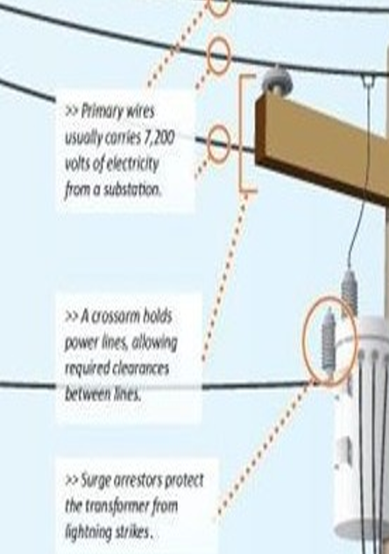
Surge Arrestors
Protects the transformer from lightening bolts.
Surge Arrestor

Slide 7
Knowing what’s on a pole helps prevent accidents and improves field awareness.
Primary Wires
Primary power lines-carry thousands of volts and strictly off limits for telecom workers.
Crossarms-horizontal beams holding the power lines apart.
Surge arrestors-the surge protection for the power system.
Crossarm
Surge Arrestor

Slide 8

Thank You for attending

